Slide 1

CAPSTONE PROJECT
Fandango Movie Rating Discrepancy Analysis
Presented by:
Hamsadevi.M
Department of Ceramic Technology
Anna University,Chennai

Slide 2
AGENDA
Problem Statement
Problem Solution
System Approach
Algorithm and Deployment
Result
Conclusion
Future Trends
Reference

Slide 3
PROBLEM STATEMENT
Comparative Analysis of Fandango's Movie Review System Against Other Leading Movie Review Websites based on historical data.

Slide 4
PROBLEM SOLUTION
Identify a set of leading movie review websites for comparison alongside Fandango. Consider factors such as popularity, diversity of content, and user engagement.
Utilize web scraping techniques or APIs to gather data from Fandango and the selected movie review websites. Collect information on user ratings, reviews, rating scales, user interface design, and user engagement metrics.
Cleanse and preprocess the collected data to ensure consistency and compatibility for analysis. Handle missing values, outliers, and inconsistencies in the data.
Extract relevant features from the collected data, such as average rating, review counts, user engagement metrics, and UI design elements.
Create visualizations such as charts, graphs, and tables to illustrate the findings of the comparative analysis. Interpret the results to identify strengths and weaknesses of Fandango relative to other platforms.
Summarize the findings of the comparative analysis and draw conclusions about the performance and user experience of Fandango's movie review system compared to other leading movie review websites. Provide recommendations for potential improvements or enhancements to Fandango's platform based on the insights gained from the analysis.

Slide 5
SYSTEM APPROACH
Building the proposed solution would involve a combination of data processing, feature engineering, and machine learning. Here are the key system and library requirements:
System Requirements:
1.Hardware:
A computer with sufficient processing power, preferably with multiple cores or a GPU for faster training of machine learning models.
Adequate RAM to handle the size of the dataset and computational requirements.
2.Software:
An opening system compatible with the required machine learning libraries(e.g., Windows, Linux, macOS).

Slide 6
SYSTEM APPROACH
Library Requirements:
1.Data Processing and Analysis:
Pandas: For data manipulation ad analysis.
NumPy: For numerical operation on data.
2.Data Visualization:
Matplotlib and Seaborn: For creating visualization to understand data patterns
Plotly or Bokeh: Interactive visualization libraries for more complex visualizations.

Slide 7
ALGORITHM AND DEPLOYMENT Algorithm Selection
Data Exploration:
Explore the movie review datasets’s structure, features, and target variable(s)
Identify potential patterns, correlations, and outliers.
Problem Formulation:
Define the problem: Comparing the reviews of various movie with other links and likelihood of special requests based on historical data.
Algorithm Selection:
1.Regression tasks (e.g., predicting movie reviews):
Consider linear regression, decision trees, or ensemble methods (XGBoost, LightGBM).
2.Classification tasks (e.g., predicting special requests):
Consider logistic regression, decision trees, or random forests.

Slide 8
ALGORITHM AND DEPLOYMENT Data Input
Data Collection:
Gather old movies reviews , including the various websites reviews and rating.
Data Cleaning:
Handle missing values,outliers, and any inconsistencies in the dataset.
Convert categorical variables into numerical representations through encoding techniques.
Feature Engineering:
Create new features or modify existing ones based on domain knowledge.
Extract meaningful information from data variables, such as day-of-week or month

Slide 9
ALGORITHM AND DEPLOYMENT Training Process
Data Splitting:
Divide the dataset into training and testing sets to evaluate the model’s performance
Feature Scaling:
Standardize or normalize numerical features to ensure they have a consistent scale.
Model Training:
Use the selected algorithm to train the model on the training dataset.
Adjust hyperparameters to optimize model performance.
Model Evaluation:
Evaluate the model on the testing dataset using appropriate metrics.
Fine-tune the model if necessary.

Slide 10
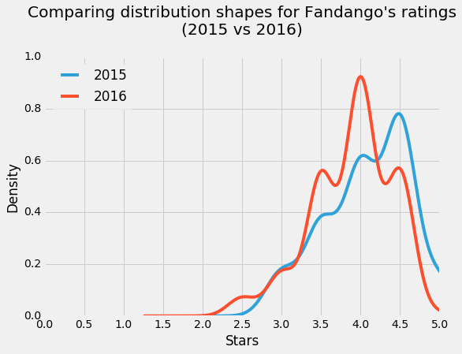
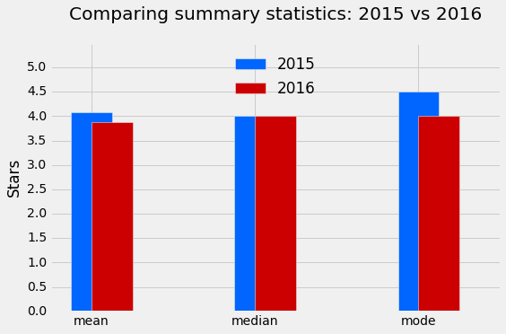
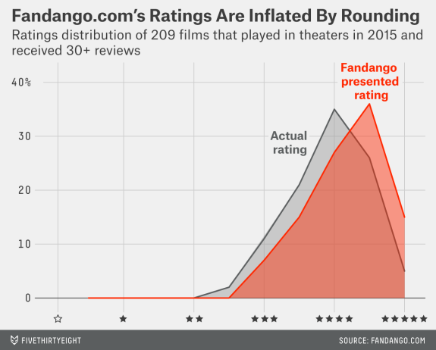
RESULT

Slide 11
CONCLUSION
In conclusion , our proposed solution harnesses the power of advanced machine learning algorithms to transform the movie rating system into a dynamic and optimized experience. By meticulously analyzing extensive historical booking data, we unlock patterns and correlation that are pivotal in addressing key challenges faced by reviewers.

Slide 12
FUTURE TRENDS
The proposed solution lays the foundation for ongoing advancements in the realm of movie review optimization.Here are key areas for future exploration and enhancement.
Real-time Predictions:
Move towards real-time predictive modls that account for instant changes in demand, external events, and other dyanamic factors to provide users with up-to-the minute insights for reviewing

Slide 13
REFERENCE
Kaggle: Your Machine Learning and Data Science Community
seaborn: statistical data visualization — seaborn 0.13.2 documentation (pydata.org)
Matplotlib — Visualization with Python

